Slide 1
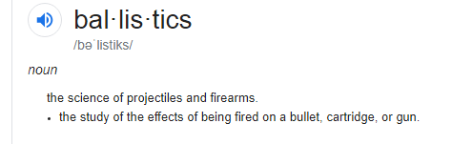
Ballistics
https://www.google.com/search?q=ballistics&oq=ballistics&aqs=chrome.0.69i59l2j0l3j69i60.2903j0j4&sourceid=chrome&ie=UTF-8
Notes:
Ballistics is the area of study dealing with the motion of projectiles, i.e., bullets, and is further divided into internal ballistics, the study of projectiles in the weapon; external ballistics, the behavior of the projectile through air; and terminal ballistics, the study of the penetration of a medium denser than air by projectiles (Barach et al., 1986; Belkin, 1978; Di Maio, 1985; Ordog et al., 1984). From http://www.southampton.ac.uk/~jb3/bullet/gsw.html
Modern handguns (clockwise from top left) Glock 22 * Glock 21 * Kimber Stainless Raptor II * Dan Wesson Commander Classic Bobtail * Smith & Wesson Model 340 * Ruger Blackhawk * Ruger SP101 * SIG Sauer P220 Combat.

Slide 2
พระราชบัญญัติอาวุธปืน เครื่องกระสุนปืน วัตถุระเบิด ดอกไม้เพลิง และสิ่งเทียมอาวุธปืน พ.ศ.2490
มีเครื่องกระสุนไว้ในครอบครองโดยไม่ได้รับอนุญาต(ไม่ถูกขนาดกับปืนที่มีใบอนุญาต)
อัตราโทษ ต้องระวางโทษจำคุกไม่เกิน 10 ปี หรือปรับไม่เกิน 20,000 บาท หรือทั้งจำทั้งปรับ การประกันตัว(เงินสด) ประมาณ 20,000-50,000 บาท
http://wanlop-style.blogspot.com/p/blog-page_23.html

Slide 3
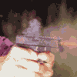
Introduction to firearms and their ammunition
General firearms used to commit the crimes
Handguns, rifles, shotguns
Accompanying ammunition for firearms commonly contain
Cartridge case, a primer, propellant and a projectile (i.e. bullet) or projectiles (i.e. shot)
Notes:
องค์ประกอบของเครื่องกระสุนปืน
ลูกกระสุนปืน bullet
ดินปืน หรือ ดินส่งกระสุนปืน (propellant or gunpowder)
ปลอกกระสุนปืน cartridge case
แก็ปปืน primer

Slide 4
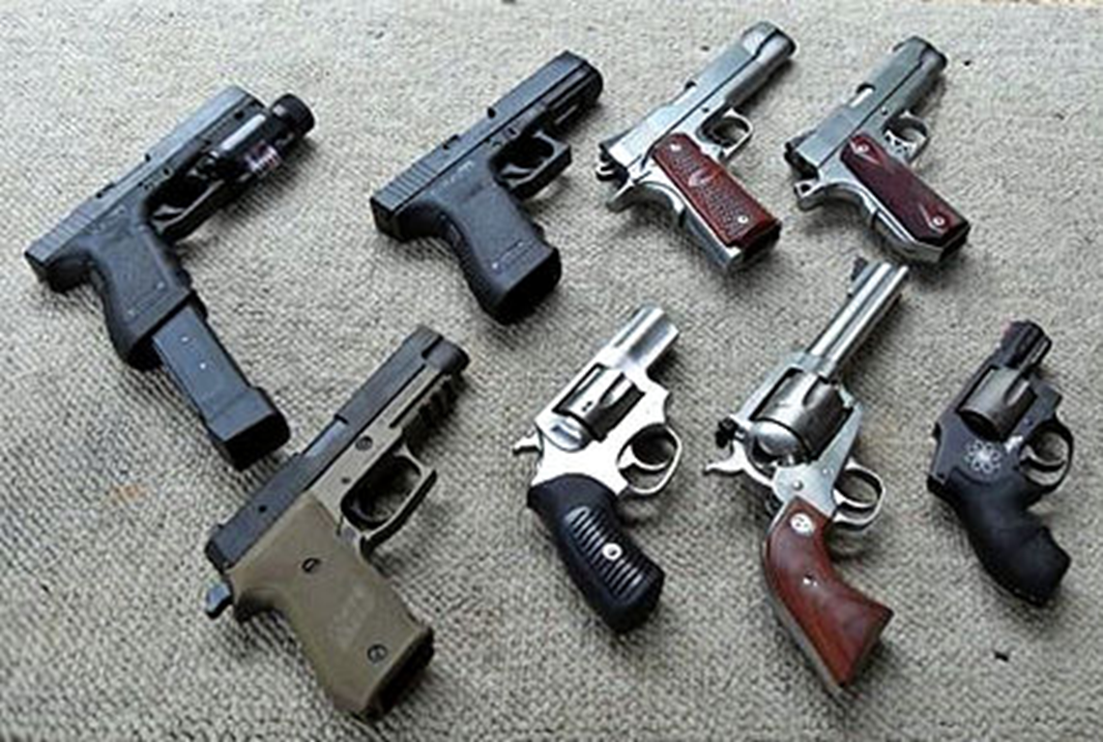
Handguns
A firearm designed to be held in and discharged from one hand, whether single-shot, self-loading or revolver in design
https://en.wikipedia.org/wiki/Handgun
Notes:
Modern handguns (clockwise from top left) Glock 22 * Glock 21 * Kimber Stainless Raptor II * Dan Wesson Commander Classic Bobtail * Smith & Wesson Model 340 * Ruger Blackhawk * Ruger SP101 * SIG Sauer P220 Combat.
Model: 315 Caliber: .38+P Capacity: 6 Rounds Barrel Length: 2 1/2" Front Sight: XS® Sight 24/7 Standard Dot Tritium Sights Rear Sight: Cylinder & Slide Extreme Duty Fixed Overall Length: 7" Weight: 24 oz. = ?? kg Grip: Pachmayr® Compac Custom Material: Scandium Alloy Frame/Stainless PVD Cylinder Finish: Matte Black Model: 952 Caliber: 9mm Capacity: 9+1 Rounds Barrel Length: 6" Front Sight: Dovetail Black Patridge Rear Sight: Wilson® Micro Adjustable Grip: 2-Piece Walnut Checkered Panel Frame: Large Finish: Matte Finish with Polished Accents Overall Length: 9.5" Material: Stainless Steel Weight Empty: 39.2 oz. = ?? kg

Slide 5
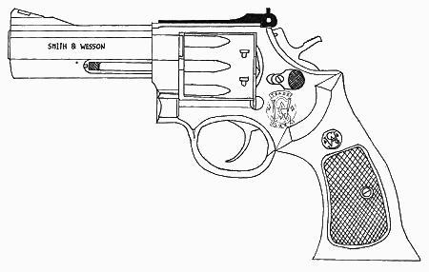
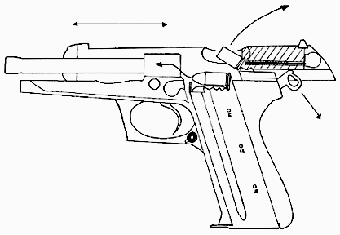
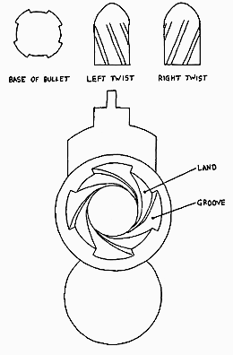
Anatomy of the Gun
Muzzle
Chamber
Barrel
Hammer
Bore
Magazine
(Clip)
Caliber
Rifling
Notes:
Muzzle ปลายกระบอกปืน
Chamber รังเพลิง
Barrel ลำกล้องปืน

Slide 6
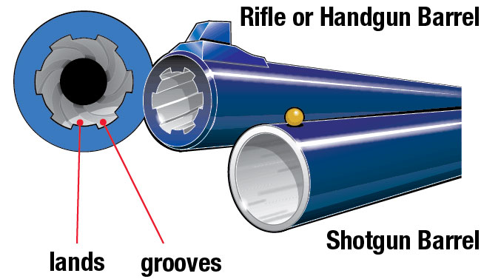
lands: The ridges of metal between the grooves in a rifled bore;
grooves: The spiral cuts in a rifled bore
Rifling is the term given to the spiral grooves cut into the bore of the a barrel which impart a stabilizing to the bullet. This spin keeps the bullet travelling in a point-first direction and lessens any tendency for it to depart from its straight line of flight.
https://www.hunter-ed.com/pennsylvania/handbook/book.html?page=14
Notes:
A bullet fired from a rifle or handgun has a spiral spin that keeps it point-first in flight, increasing accuracy and distance. This is made to happen by the rifling inside the barrel, from which the rifle got its name. The barrel is thick and has spiraling grooves cut or pressed into the bore. The ridges of metal between the grooves are called lands. Together, the grooves and lands make up the “rifling.”

Slide 7
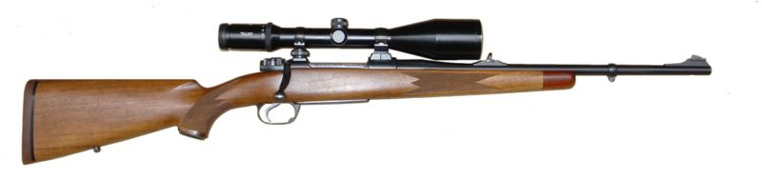
Rifles
A firearm with a rifle barrel, which fires bullets and that is designed to discharged while held in both hands, in most cases, while held against a shoulder.
Modern hunting rifle

Slide 8
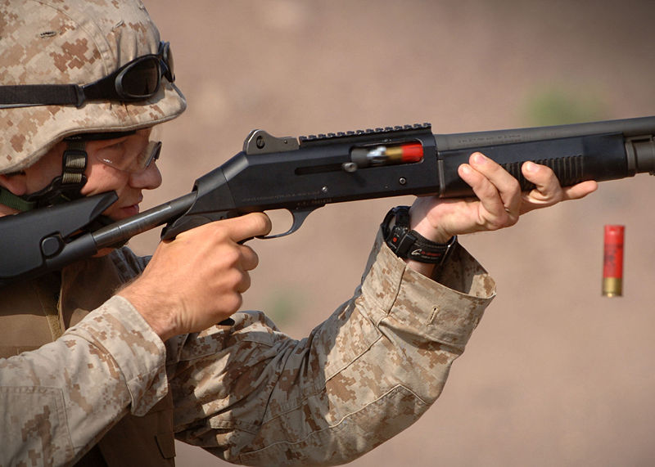
Shotguns
A firearm, the barrel or barrels of which have a smooth (i.e. not rifled) interior and which is designed to fire shot, and to be discharged while held in both hands and, in most cases, while held against shoulder.
A U.S. Marine fires a Benelli M4 shotgun during training
http://en.wikipedia.org/wiki/shortguns
Notes:
Shotguns come in a wide variety of forms, from rimfire models with 5.5 mm (.22 inch) bores up to massive punt guns with 5 cm (2 inch) bores, and in nearly every type of firearm operating mechanism. The common characteristics that make a shotgun unique center around the requirements of firing shot. These features are the features typical of a shotgun shell, namely a relatively short, wide cartridge, with straight walls, and operating at a relatively low pressure.
Ammunition for shotguns is referred to in the USA as shotgun shells, shotshells, or just shells (when it is not likely to be confused with artillery shells). The term cartridges is standard usage in the United Kingdom. Single projectile loads are generally called shotgun slugs or just slugs.
The shot pellets from a shotgun spread upon leaving the barrel which makes it easier to hit small targets at suitable ranges than with a rifle. The shot is usually fired from a smoothbore barrel; another configuration is the rifled slug barrel, which is used to fire a single projectile (though some slugs can also be fired from smoothbore weapons).
Since the power of the burning charge is divided among the pellets, the energy of any one ball of shot is fairly low, making shotguns useful primarily for hunting birds and other small game. However, the large number of projectiles makes the shotgun useful as a close-combat weapon or defensive weapon, where the short range ensures that many of the projectiles of shot will hit the target (see riot shotgun and combat shotgun).

Slide 9
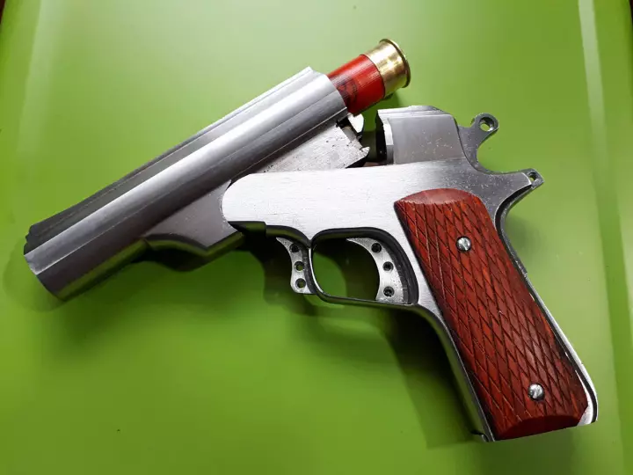
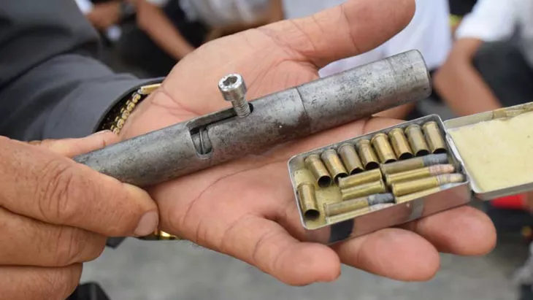
www.thairath.co.th/news/local/central/1121197
ปืนไทยประดิษฐ์ ลูกซองสั้น (อีโบะ)
ปืนปากกาสำหรับกระสุนขนาด .22
https://www.thairath.co.th/content/649681

Slide 10
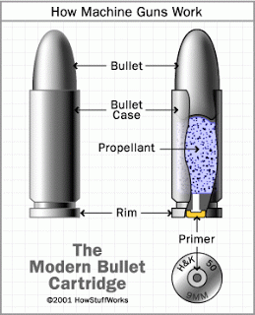
Cartridge (firearm)
Cartridge is composed of (1) bullet, (2) bullet case or cartridge case, (3) gun powder or propellant and (4) primer.
Bullet designs have to solve two primary problems.
They must first form a seal with the gun's bore.
The bullet must also engage the rifling without damaging the gun's bore. Bullets must have a surface which will form this seal without causing excessive friction.
http://airsoftbobby.blogspot.com/2009/03/info-how-ballistic-works.html
Notes:
Bullet designs have to solve two primary problems. They must first form a seal with the gun's bore. The worse the seal, the more gas, generated by the rapid combustion of the propellant charge, leaks past the bullet, reducing the efficiency. The bullet must also engage the rifling without damaging the gun's bore. Bullets must have a surface which will form this seal without causing excessive friction. What happens to a bullet inside the bore is termed internal ballistics. A bullet must also be consistent with the next bullet so that shots may be fired precisely
เส้นผ่านศูนย์ของหัวกระสุนต้องมีขนาดพอดีกับเส้นผ่านศูนย์กลางของ gun barrel (gun bore) รวมไปถึงหัวกระสุนต้องสัมผัสพอดีกับ rifling ที่อยู่ภายใน gun bore ด้วย
Cartridge = a small tube containing an explosive substance and a bullet for use in a gun
หัวกระสุนต้องมีขนาดพอดีกับ gun’s bore เพื่อป้องการรั่วของแก๊สที่เกิดจากการะเบิดของ gunpowder คือเราต้องการแก๊สที่เกิดจากการระเบิดทั้งหมดกระทำต่อ bullet ได้เต็มที่
นอกจากนี้หัวกระสุนต้องไม่แข็งจนเกินไปจนไปทำลายร่องเกลียวสันเกลียวในลำกล้องด้วย และผิวสัมผัสของ bullet ต้องไม่ก่อให้เกิดความเสียงดทานมาจนเกินไป
Primer ประกอบด้วย lead antimony และ barium
Propellant ประกอบด้วย nitrocellulose และ nitroglycerine

Slide 11
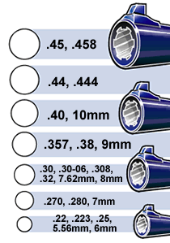
Bullet caliber
The bore is the diameter of the inside of the gun’s barrel.
Caliber describes the size of the cartridge designed for a specific bore.
The diameter of the barrel (the bore) is basically the same as the caliber the gun uses.
The caliber (size of bullet, left) has to fit the bore (right).
http://www.leelofland.com/wordpress/?p=734
Notes:
Barrel กระบอกปืน
Bore เส้นผ่านศูนย์กลางภายในปากกระบอกปืน
Caliber size ขนาดของลูกกระสุนปืนที่พอดีกับ bore

Slide 12
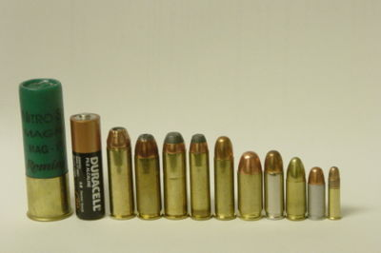
Caliber is expressed in terms of inches or millimeters. A .22 cartridge, for instance, is approximately a quarter-inch in diameter. The photo below gives an excellent visual of various calibers:
Common handgun cartridges (left to right): 3-inch 12-gauge magnum shotgun shell (for comparison), size “AA” battery (for comparison), .454 Casull, .45 Winchester Magnum, .44 Remington Magnum, .357 Magnum, .38 Special, .45 ACP, .38 Super, 9 mm Luger, .32 ACP, .22 LR
Notes:
ลูกปืนลูกซองขนาด 12 gauge ใช้กับปืนลูกซองที่มีความกว้างปากลำกล้องที่พอดีกับลูกเหล็กกลมที่มีมวล 1/12 ปอนด์

Slide 13
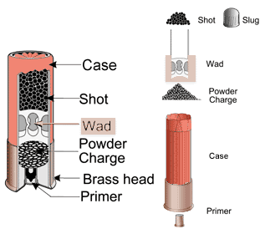
What inside a shotgun cartridge.
In addition to a case, primer, and powder, there is also a wad of plastic or fiber separating the shot from the powder. Instead of a bullet, shells are filled with “shot” – small, round pellets usually made of lead or steel.
Notes:
Shotgun shells are different from rifle and pistol cartridges. In addition to a case, primer, and powder, there is also a wad of plastic or fiber separating the shot from the powder. The wad forms a seal to allow the gases from the burning powder to push the shot down the barrel in a uniform manner. Instead of a bullet, shells are filled with “shot” – small, round pellets usually made of lead or steel.
A shotgun shell can contain anywhere from a half-dozen ball-bearing-type pieces of metal to 1,300 pellets. It can also contain a slug, which is a solid piece of metal.

Slide 14
Physics and ballistics
The physics of projectiles in motion is called "ballistics.
The physics of ballistics related to firearms is divided into three separate fields:
Internal Ballistics - The study of what happens inside of the firearm.
External Ballistics - The study of what happens during the bullet's flight.
Terminal Ballistics - The study of what happens when the projectile strikes the target.

Slide 15
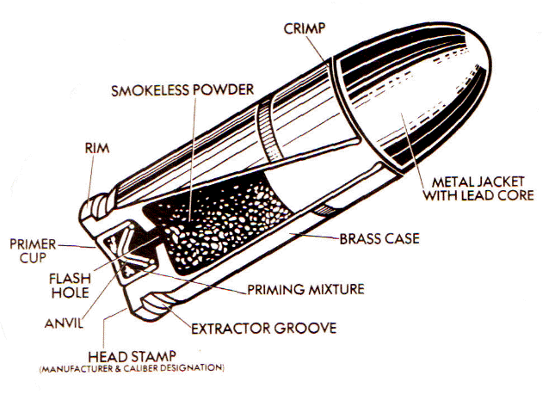
Internal ballistic : What happens when
the trigger is pulled?
Primer fired,
Intense flame passing through the flash hole,
Powder burns, creating large gas expansion
Generated huge pressure pushing bullet
The pressure also causing the gun recoil.
All primer explosives currently manufactured in the U.S. use chemical ingredients that are non-mercuric and noncorrosive. The compounds that are used vary: lead styphnate, barium nitrate, and antimony sulfide are most commonly used.
https://forum.thefreedictionary.com/postst101951_Samuel-Colt--1814-.aspx
Notes:
When the trigger is pulled the hammer hits the firing pin. The firing pin then hits the primer which causes the powder to burn hence producing lots of gases. This causes the volume behind the bullet to fill with extremely high pressure gas. The gas pushes on every surface it encounters, including the bullet in front of it and the base of the gun barrel behind it. The increase in pressure caused by the gases causes the bullet to be forced into the barrel hence causing the bullet to come out the muzzle at very high speeds. Once the bullet is fired, it remains in motion from its momentum. The momentum will carry the bullet until it strikes an object or gravity pulls the bullet towards the earth.
The force which acts on the rear of the bullet to propel it forward is also exerted on the base of the cartridge case to move the gun backward.
This force not only drives the gun to the rear but because the barrel is situated above the hand and therefore above the rotational axis of the wrist, it also
Rotates the gun in an upward direction.
As the bullet is travelling down the bore during the period in which the barrel is lifting, it will strike the target above the point at which the barrel was pointed when the trigger was pulled.

Slide 16
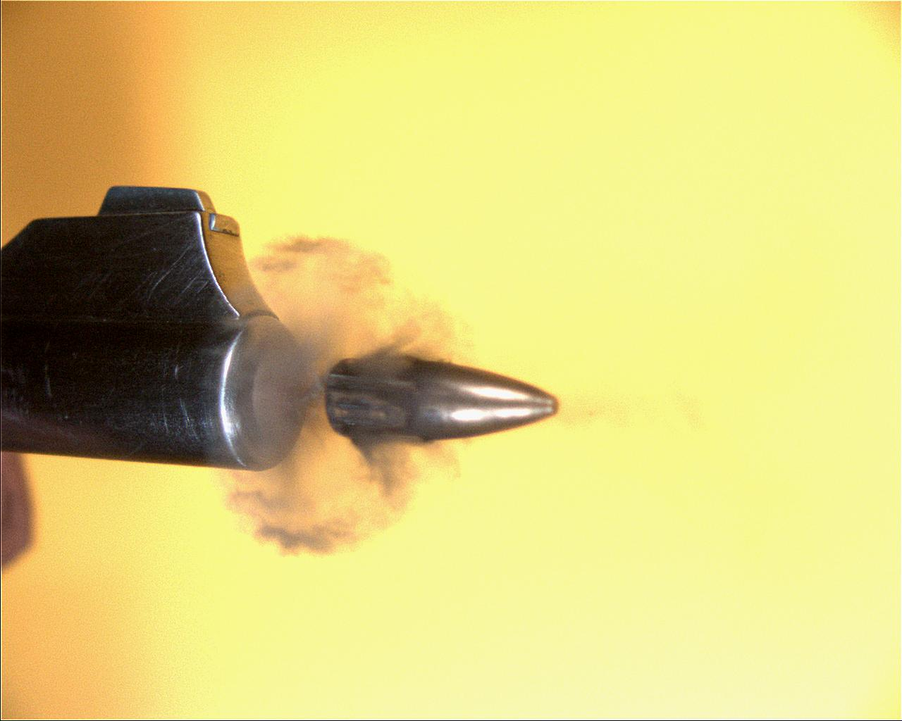
External Ballistics
The study of projectile behavior after discharge from the firearm but prior to impact with the target.
Two main factors considered to affect the bullet trajectory are gravity and air resistance.
A bullet is being fired from a revolver.

Slide 17
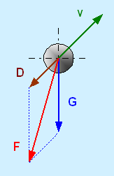
Free body diagram of an object in flight
Basic forces acting on an object on flights are the gravity force (G) and drag force (D).
The drag D is in exactly opposite direction of the velocity v.
The resultant force F resists the motion of the object in flight.
http://www.codeproject.com/Articles/19107/Flight-of-a-projectile
Notes:
Note this is simplified version of the flight analysis. In real bullet flight, spin of the bullet has to be considered. The spin keeps the bullet stable by piercing pass air.

Slide 18
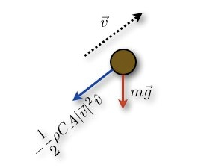
Gravity and drag
http://www.wired.com/wiredscience/2013/03/how-difficult-is-a-70-yard-field-goal/
Drag forces are many times that of gravity at high velocities, particularly when the object is supersonic.
The gravity can simply written as G = mg.
The drag depends on many factors such as the density of the atmosphere ρ, the cross sectional area of the object A, the drag coefficient C_{d} and the square of the object velocity v = (v_{x}² +v_{y}²)^{1/2}, i.e., D = (1/2)ρAC_{d}v²

Slide 19
Equations of motion
According to the second Newton’s law of motion : ΣF = ma, forces acting on the object can be separately written in horizontal x and vertical y directions as
F_{x} =ma_{x}= -D_{x} and F_{y} =ma_{y}= -D_{y}-G
The resultant force gives rise to a unique object trajectory which is very much different from the motion without the drag.

Slide 20
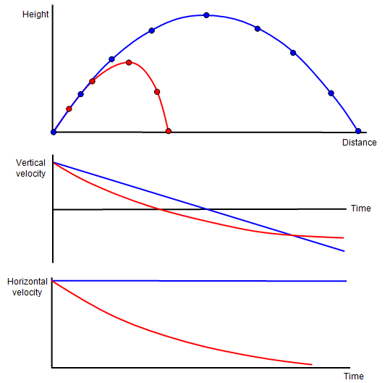
How are the object motions affected by drag?
Both the range of a projectile and the maximum height that it reaches are affected by air resistance.
The blue lines show the projectile without air resistance and the red lines show what happens when air resistance is taken into account.
The maximum height, the range and the velocity of the projectile are all reduced.
Trajectory with drag reaches the highest point first.
Trajectory with drag has a non uniform horizontal velocity.
http://www.schoolphysics.co.uk/age16-19/Mechanics/Kinematics/text/Projectiles_and_air_resistance/index.html
Notes:
The first graph reveals different trajectories between object motions with and without air resistance.
The second graph show different time the object takes to go up an down also different velocities when the object passes the same points (in case of having air resistance)
The third graph shows the change of horizontal velocity due to the air resistance.

Slide 21
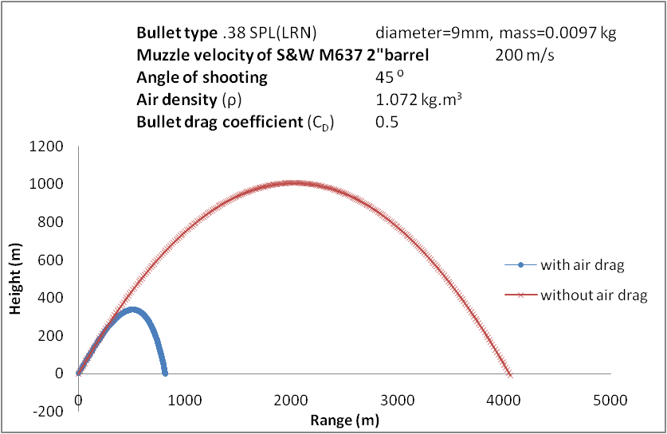
Trajectory of a bullet
with and without air drag

Slide 22

Google map แสดงระยะกระจัดจากคณะวิทยาศาสตร์ ไปยังรพ ราชวิถี
ระยะทางประมาณ 1.01 กิโลเมตร

Slide 23
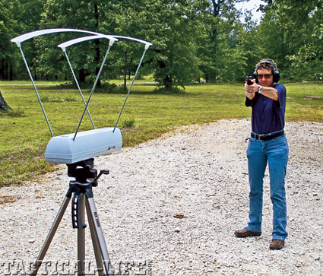
Muzzle velocity
The muzzle velocity is simply the speed at which a projectile leaves the muzzle of a weapon and can be measured by a chronograph.
Muzzle velocity measured by a chronograph
https://www.tactical-life.com/combat-handguns/mastering-bullet-velocities/

Slide 24
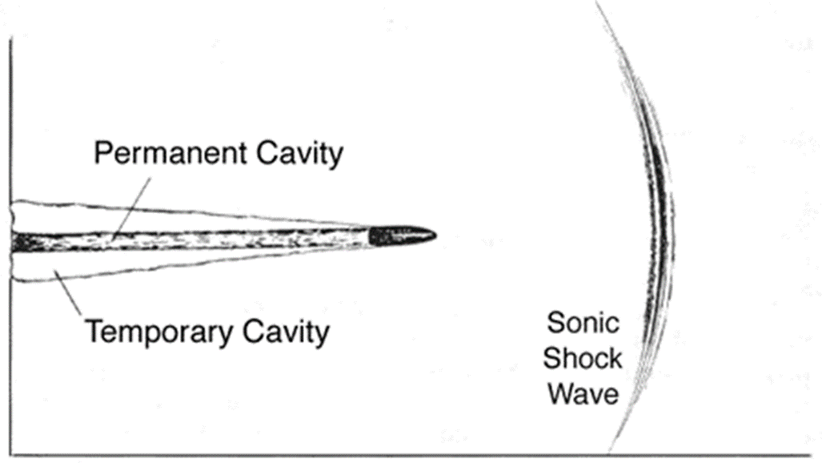
Terminal Ballistics
The study of the behavior of projectiles when they strike their targets.
What happens when bullets hit the intended depend on the kinetic energy of the bullet that remains on impact and also on the target itself.

Slide 25
Tissue damaged by bullets
The passing bullet through human tissue transfer some kinetic energy to the surrounding tissue.
The tissue is radially thrown away leaving a temporary cavity much larger than the diameter of the bullet.
The temporary cavity results from the elasticity of the tissue which allows to regain its original structure after the bullet has passed.
There is also a permanent cavity which results from the destruction of tissue caused by the bullet itself.
Notes:
Bullets produce tissue damage in three ways (Adams, 1982):
Laceration and crushing - Tissue damage through laceration and crushing occurs along the path or "track" through the body that a projectile, or its fragments, may produce.
Cavitation - A "permanent" cavity is caused by the path (track) of the bullet itself, whereas a "temporary" cavity is formed by continued forward acceleration of the medium (air or tissue) in the wake of the bullet, causing the wound cavity to be stretched outward.
Shock waves - Shock waves compress the medium and travel ahead of the bullet, as well as to the sides, but these waves last only a few microseconds and do not cause profound destruction at low velocity. At high velocity, generated shock waves can reach up to 200 atmospheres of pressure. (DiMaio and Zumwalt, 1977) However, bone fracture from cavitation is an extremely rare event. (Fackler, 1996) The ballistic pressure wave from distant bullet impact can induce a concussive-like effect in humans, causing acute neurological symptoms. (Courtney and Courtney, 2007)
Dense target -> energy dissipation quickly -> minimal depth of penetration.
Low velocity bullet; i.e. less than 300 m/s damages the target by penetration and crushing.
High velocity bullet; i.e. greater than 500 m/s penetrates the target and followed by the production of a cavity.

Slide 26
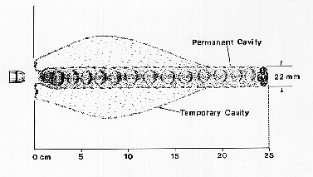
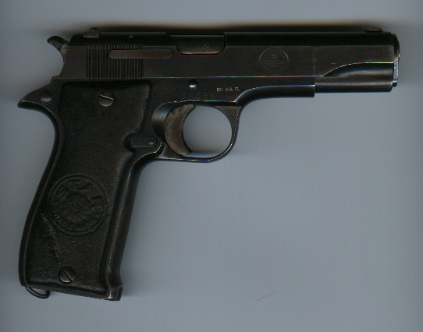
Wound Profile from a handgun
Neck
.32 Cal. Silvertip Winchester
-soft lead
-Non-fragmenting, expanding
-Velocity: 940 fps (similar to present day .22 cal)
Fackler, et al. Annals of Emergency Medicine. 1996

Slide 27
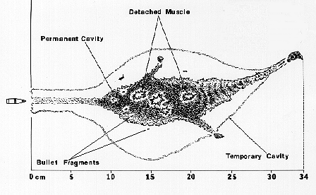
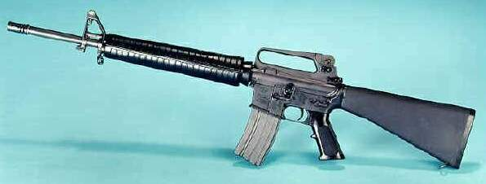
Wound Profile from a rifle
M-16 .22 Cal Military Rifle
-Full Metal Jacket
-Fragmenting rifle bullet
-Velocity = 3035 fps

Slide 28
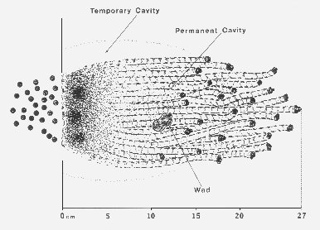
Wound Profile from a shotgun
12 gauge shotgun
- 27 pellet #4 buck shot
- Velocity = 1350 fps

Slide 29
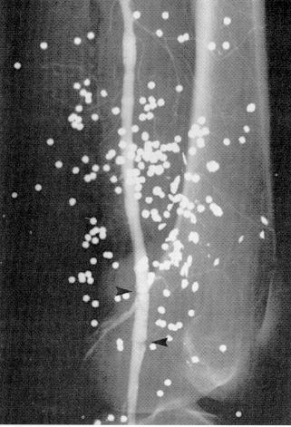
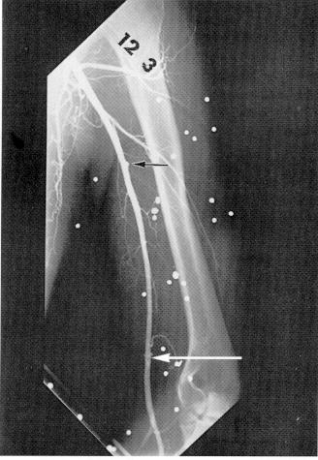
Shots from a shotgun inside a body

Slide 30
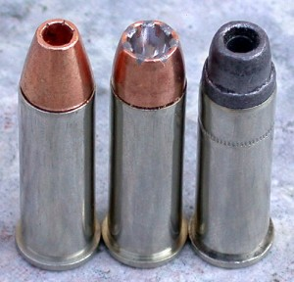
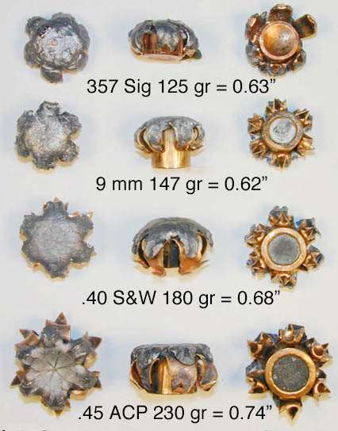
The expansion of hollow point bullet when hit the target.
http://www.guns.com/2014/03/26/federal-court-upholds-san-frans-tough-ammo-ban-gun-laws/

Slide 31
Pattern of tissue injury
Classification
One of the commonest determinations of the forensic pathologist is the range of fire. Gunshot wounds are typically classified as:
Contact
Intermediate range
Distant range

Slide 32
Contact wounds
Contact wounds – associated with contact of the barrel of the gun with the skin of the person.
There are two types of contact wounds: loose contact and tight.
A ragged stellate wound (deep cruciform tearing) can be found on bony part of the body.
In some cases the impression of the muzzle can be seen imprinted onto the skin.
Notes:
Stellate wound caused by the explosive force of the bullet being forced from the barrel and splitting or tearing the skin.
Stellate (adj) = Arranged or shaped like a star; radiating from a cente

Slide 33
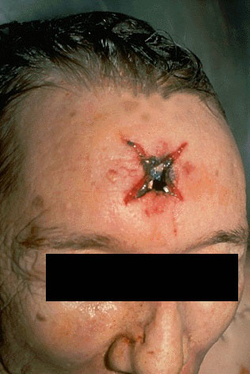
The contact gunshot entrance wound is caused by high pressure gases which follow the bullet and burst back out through the bullet entry hole.
http://www.forensicindia.com/forensic_pictures/index.htm
Notes:
Since the barrel contacts the skin, the gases released by the fired round go into the subcutaneous tissue and cause the star-shaped laceration. Note also the grey-black discoloration from the soot, as well as the faint abrasion ring.
Tight contact wounds occur when the muzzle is pressed tightly against the skin. All material that is discharged from the barrel, including soot, gases, incompletely burned gunpowder, metal fragments, and the projectile are injected into the wound. In a loose contact wound, the contact between the skin and the muzzle is incomplete, and soot and other residues will be distributed along the surface of the epithelium.

Slide 34
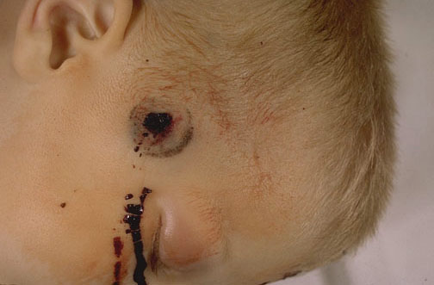
http://www.forensicindia.com/forensic_pictures/index.htm
An abrasion ring, formed when the force of the gases entering below the skin surface back against the muzzle of the gun, is seen here in this contact range gunshot wound to the right temple.

Slide 35
Intermediate range
Intermediate range : wound at distances up to 1 m are characterized by a stippling of the skin around a circular entrance wound, caused by the burning primer and propellant residues (gun shot residues : GSR) impacting and sticking to the skin.
The pattern is termed “powder tattooing”.
Density of tattooing is dependent on the distance & caliber.
Notes:
Stipple (v) เป็นจุด ๆ

Slide 36
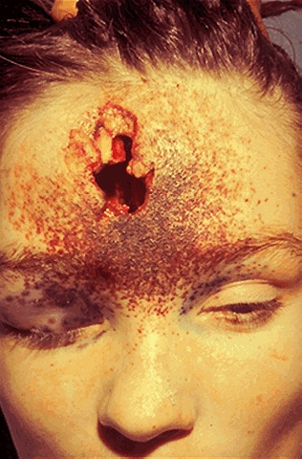
Powder tattooing is seen in this intermediate range gunshot wound. The actual entrance site is somewhat irregular, because the bullet can tumble in flight.

Slide 37
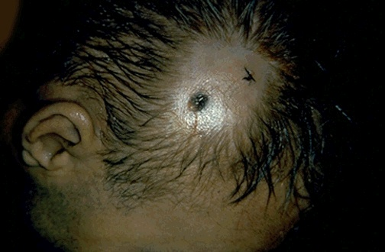
Displayed here is an entrance at the left and an exit at the right. This particular bullet struck at an angle to produce the ovoid entrance. Exit wounds vary considerably in size and shape because the bullet can be deformed in its transit through the body.
Notes:
There may be no exit wound at all if the bullet's energy is absorbed by the tissues. Some bullets (such as a "hollowpoint") are designed to deform so that all their energy will be converted to tissue damage and not exit.

Slide 38
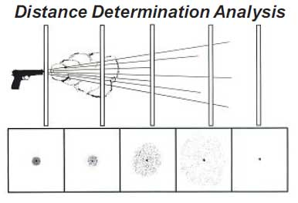
Distant range
Bullets fired at long distances, typically from high-velocity weapons, have significant amount of energy to propel them.
The bullet on impact is more destructive and severe.
http://www.crime-scene-investigator.net/how-far-will-shooting-distance-determination-take-your-case.html
Notes:
No tattooing or deposition of soot
Indentation of skin creates Abrasion collar
→friction b/w bullet and skin (not caused by heat of bullet.
→palms and soles won’t have abrasion collars.
→Angle of impact depends on shape
→Cannot determine distance

Slide 39
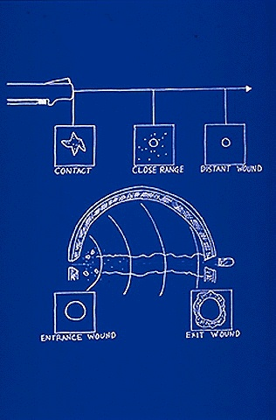
The upper diagram illustrates the basic differences between the skin appearance of a contact, close (intermediate), and distant range gunshot wound.
The lower diagram shows the beveling of the skull outward away from the direction of origin of the bullet.
Notes:
Note that the beveling can be used to indicate the impact direction of a shot bullet.

Slide 40
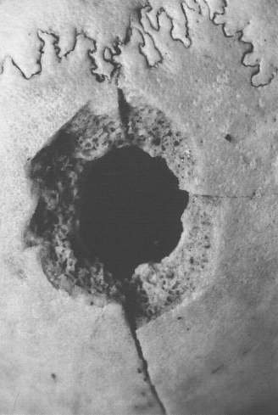
Bevelling of the skull
As the bullet exits the cranial cavity, the inner table (the inner compact layer of the bones covering the brain) appears "punched-out" with beveling on the outer table.
http://www.southampton.ac.uk/~jb3/bullet/gsw.html
Notes:
iner table of skull the inner compact layer of the bones covering the brain.
outer table of skull the outer compact layer of the bones covering the brain.
The development of radial fracture lines from the central defect is quite variable
and often dependent on the speed and size of the projectile, the bone density and
Curvature of the skull at the point of impact.

Slide 41
Exit wound
Exit wounds are generally larger than entrance wounds, due to the fact that the bullet has expanded or tumbled on its axis.
Exit wounds either do not exhibit gunshot residues or far less residues than associated entrance wounds.

Slide 42
Firearm identification
The basis of firearms identification is that no two firearms produce the exact same marks on a fired bullet or cartridge.
Comparison of bullets involves "class" and "individual" characteristics.
Notes:
The first step in a firearm identification is to look at what are called class characteristics. These are characteristics common to a particular group or family of items. In the case of a firearm these would be the caliber and rifling pattern of the barrel. The caliber of the firearms refers to the size of the bullet that is fired. Obviously a bullet that is 0.30" in diameter could not be discharged from a firearm that has an inside barrel diameter of 0.15". The rifling pattern on the inside of a barrel is often unique to a specific firearm manufacturer. This pattern is the spiral staircase pattern that can be seen when looking down the barrel of a firearm.
The individual characteristics are caused by small defects in the rifling which are produced during the manufacturing process.

Slide 43
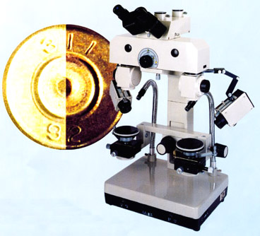
Examination of cartridges
A process similar to the one use in bullet identification is used in identifying cartridge cases. Cartridge cases are the cases that house the bullet in the firearms before it is discharged.
Comparison microscope

Slide 44
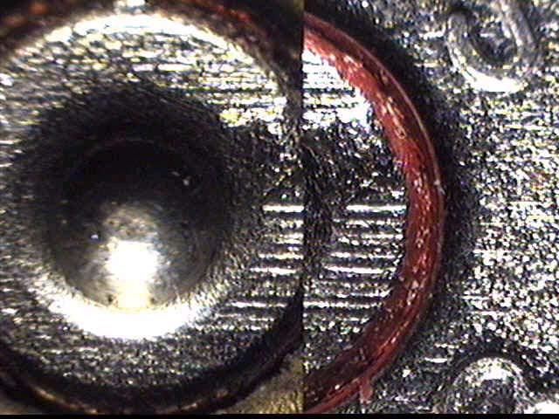
Some of the marks used to individualize a cartridge are shown below.
Marks left on Cartridge Case Near Firing Pin

Slide 45
Advanced forensic techniques
In the absence of identifiable striations, bullet-firearm linkage cannot be established. The portion of the bullet carrying faint scratches, if any, may be examined for presence of transferred metal of barrel by Scanning Electron Microscope – Energy Dispersive X-ray (SEM-EDX).
SEM-EDX gives both morphology and elemental compositions of the gunshot residue.
Notes:
SEM-EDX เป็นตัวอย่างของ hyphenated technique (เทคนิคการคู่ต่อเครื่องมือวิเคราะห์) ในที่นี้เครื่องมือวิเคราะห์ที่นำมาใช้งานร่วมกันคือ SEM และ energy dispersive x ray
ทำให้การวิเคราะห์ GSR ได้ทั้ง morphology และ ธาตุองค์ประกอบ

Slide 46
Scanning electron microscopy (SEM)
SEM can reveal the actual surface details of the particles examined, for comparison with known examples of gunshot residue (GSR) primer.
The large particles of partially burned powder and the spheres of residue can be distinguished from contaminant materials.
Notes:
Gunshot residue (GSR), also known as cartridge discharge residue (CDR), or firearm discharge residue (FDR), is residue deposited on the hands and clothes of someone who discharges a firearm. It is principally composed of burnt and unburnt particles from the explosive primer, the propellant—and possibly fragments of the bullet, cartridge case, and thefirearm
GSR ประกอบด้วย primer mixture (lead Pb, antimody Sb, barium Ba), burnt and unburnt gunpowder และ metallic components of ammuni
tion และ firearms
When the individual primer elements of lead, antimony, and barium become fused together in one single particle within a plume, evidence is created. These three-element or three-component particles are categorized as “characteristic of gunshot residue.” These are the particles for which an expert searches when analyzing hand samples, clothing samples, or surface samples for the presence of gunshot residue (GSR).

Slide 47
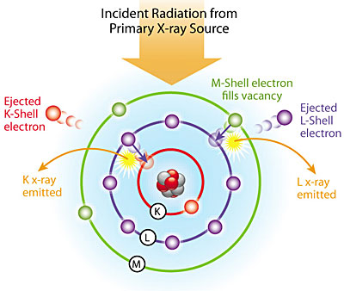
Energy dispersive X-ray analysis (EDX)
An X-ray analyzer can be beamed directly onto the particles, so that the energy dispersive pattern (EDX) can be generated, giving the elemental composition of the particles.
https://www.azom.com/article.aspx?ArticleID=5251
Notes:
NOTE sem ใช้ตรวจสอบว่า primer mixture ซึ่งประกอบด้วย lead antimony และ barium หลอมเข้าด้วยกันหรือไม่ ถ้าหลอมเข้าด้วยกันก็แสดงว่า
น่าจะเป็น particle ที่ได้มาจากการยิงปืน ส่วน edx ใช้บอกธาตุองค์ประกอบใน GSR

Slide 48
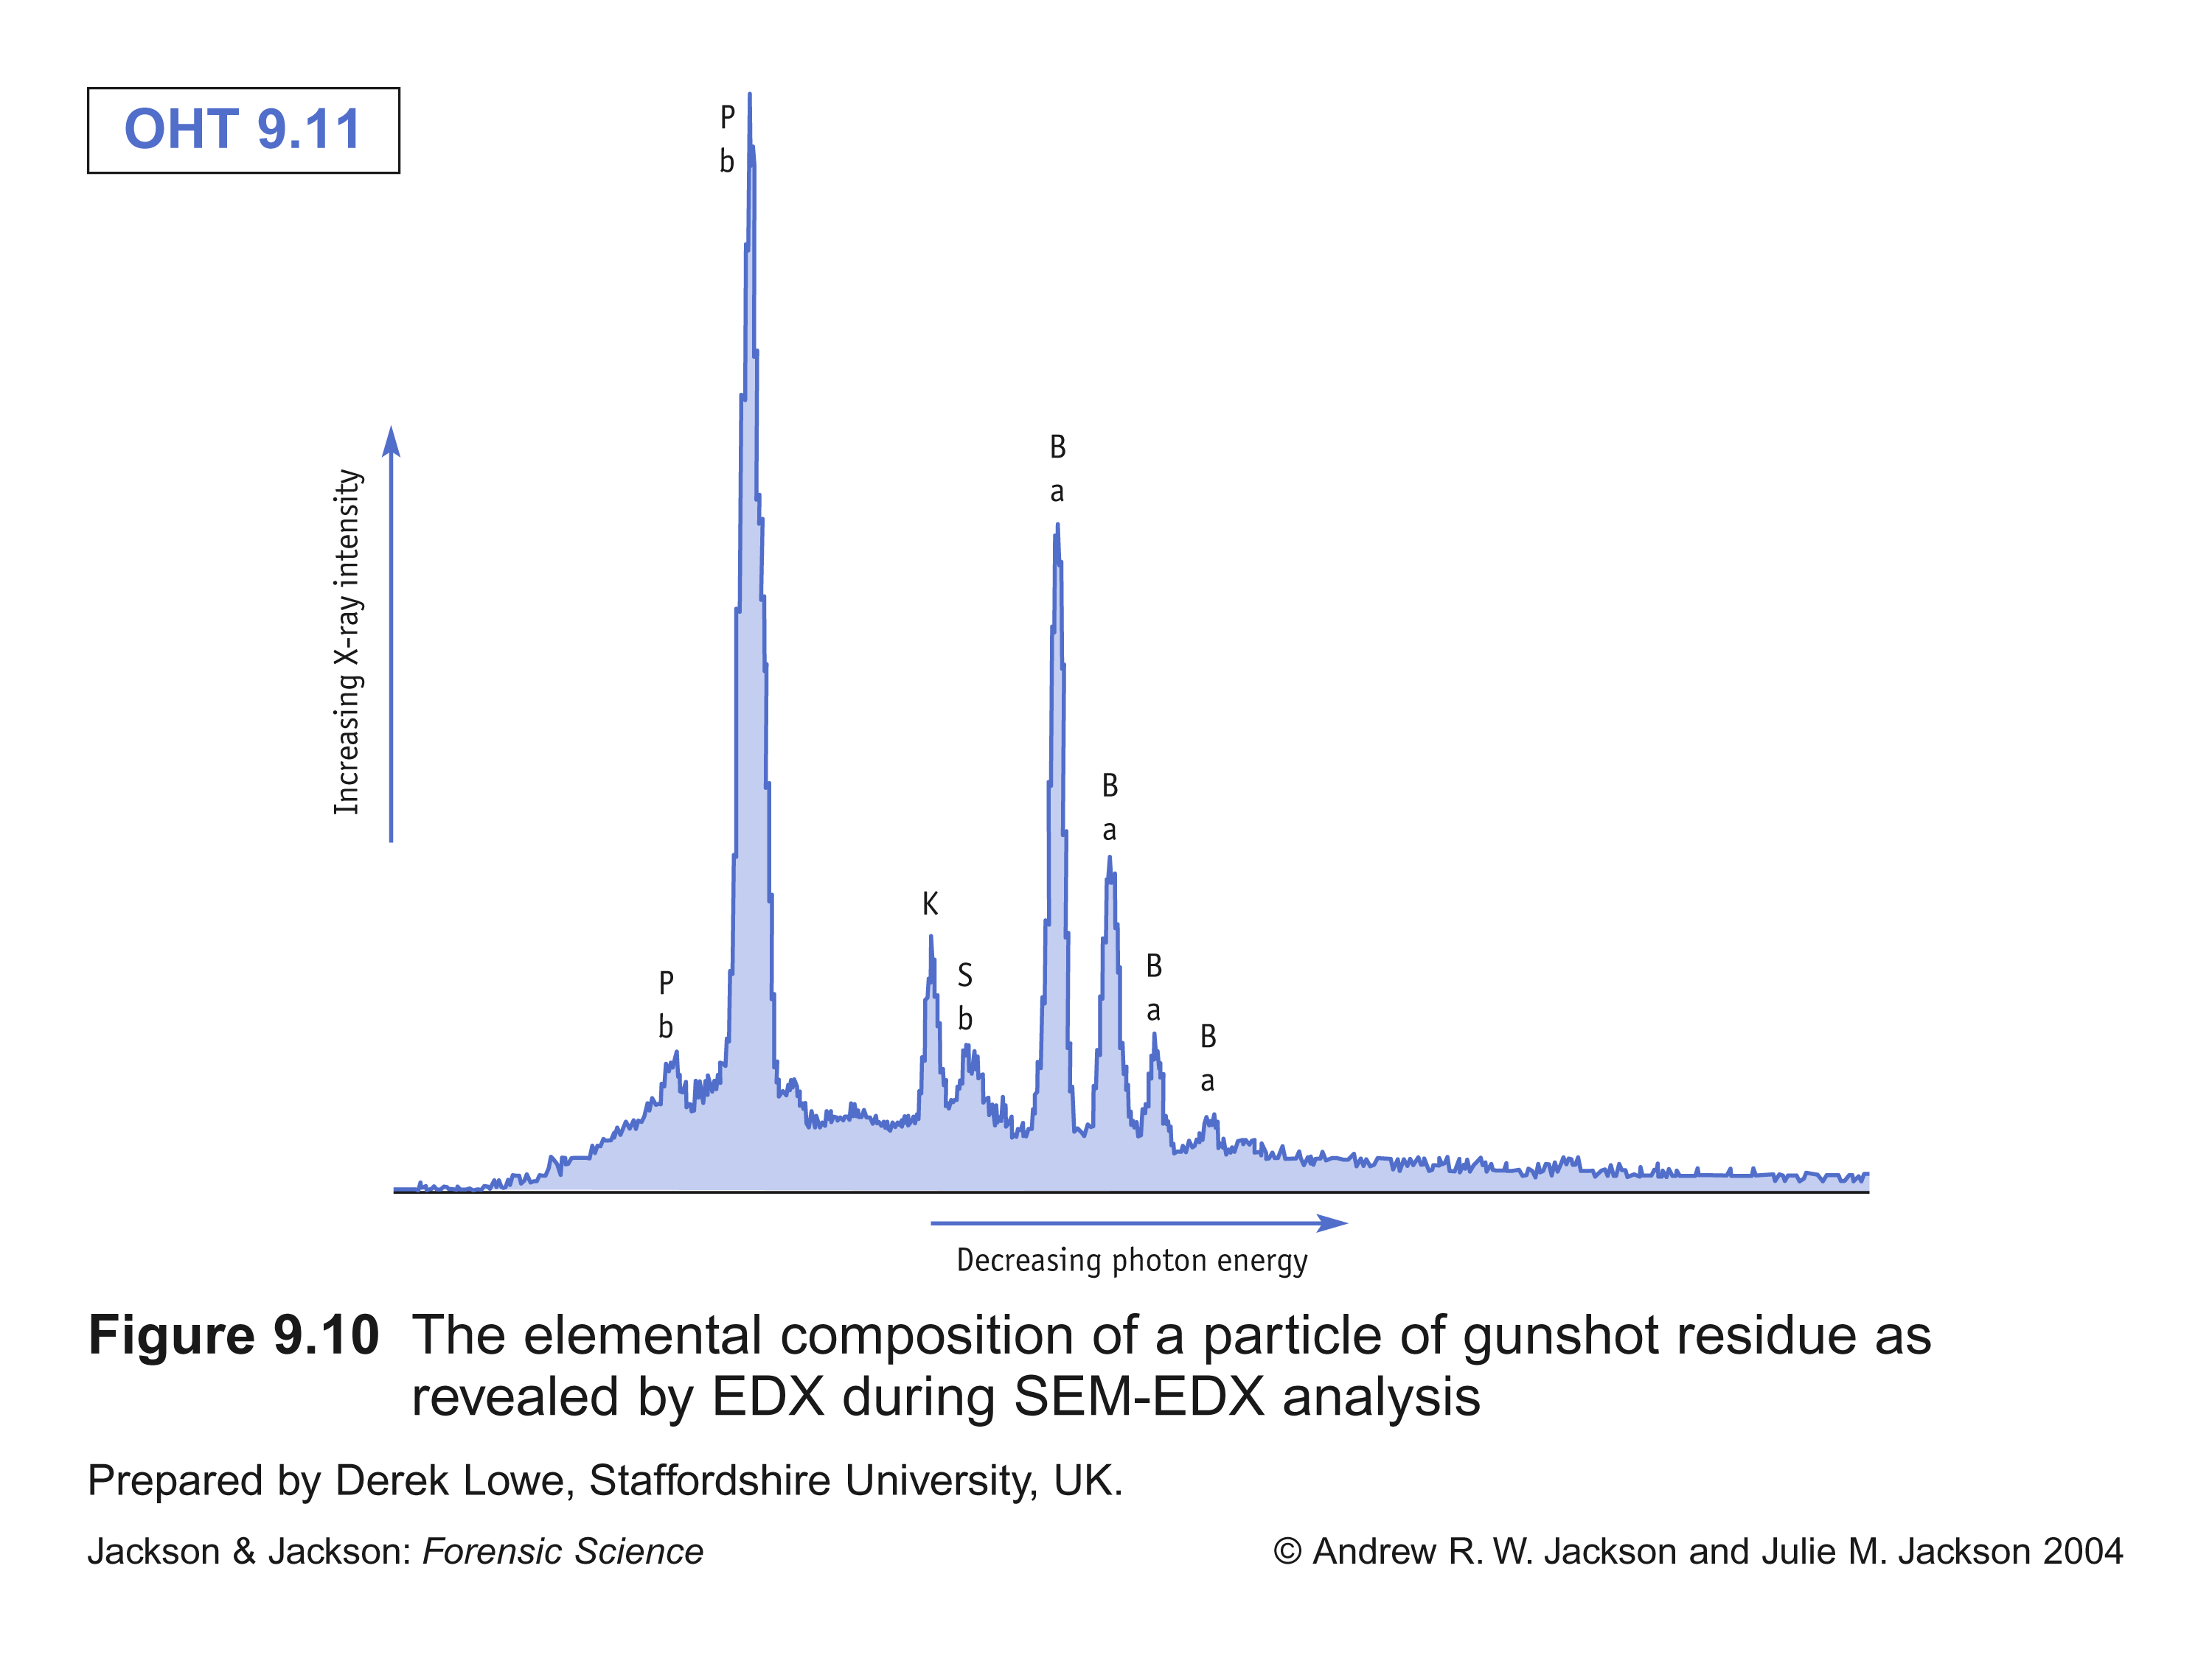
Notes:
Energy-dispersive X-ray spectroscopy (EDS or EDX) is an analytical technique used for the elemental analysis or chemical characterization of a sample. It relies on the investigation of an interaction of some source of X-ray excitation and a sample. Its characterization capabilities are due in large part to the fundamental principle that each element has a unique atomic structure allowing unique set of peaks on its X-ray spectrum.^{[2]} To stimulate the emission of characteristic X-rays from a specimen, a high-energy beam of charged particles such as electrons or protons (see PIXE), or a beam of X-rays, is focused into the sample being studied. At rest, an atom within the sample contains ground state (or unexcited) electrons in discrete energy levels or electron shells bound to the nucleus. The incident beam may excite an electron in an inner shell, ejecting it from the shell while creating an electron hole where the electron was. An electron from an outer, higher-energy shell then fills the hole, and the difference in energy between the higher-energy shell and the lower energy shell may be released in the form of an X-ray. The number and energy of the X-rays emitted from a specimen can be measured by an energy-dispersive spectrometer. As the energy of the X-rays are characteristic of the difference in energy between the two shells, and of the atomic structure of the element from which they were emitted, this allows the elemental composition of the specimen to be measured.^{[3]}

Slide 49
Physics in action
Physics of momentum in ballistics
Can a human body be displaced or knocked down by a small arms projectile?

Slide 50
The physics of momentum in the case of a bullet hitting a person
If the person does not move before being hit and the bullet remains in the body (highest transfer of momentum), the conservation of momentum can be written as
Given that p₁, p₂ is the momentum of the bullet and momentum of the bullet+body, respectively.
p₁ = p₂
m₁v₁ = (m₁+m₂ )v₂
v₂ = (m₁/(m₁+m₂))v₁ ≈(m₁/m₂)v₁
Notes:
In this case we consider the situation when the highest transfer of motion to the body results when the bullet remains in the body (or in a ballistic vest worn by the person).

Slide 51
Determine the throwback speed
This table is for the calculation of the throwback speed of a 80 kg body and the bullet remains in the body.
Cartridge | m(g) | v₁ (m/s) | p₁ (N.s) | V₂ (m/s)
.22 lr | 2.5 | 330
9 mm | 8.0 | 350 |  | 0.035
.45 magnum | 14.9 | 260 |  | 0.049
.357 magnum | 17.5 | 835 | 14.6 | 0.18
0.85
0.01
2.8
3.87

Slide 52
Conclusions : physics in action
Can a human body be displaced or knocked down by a small arms projectile?
The answer is ……...
The throwback speed found is negligible. In other words, the momentum transferred from the bullet has no noticeable effect on the target body.
Notes:
When a person commit suicide while firmly holding the gun, the total momentum of the body/weapon system consequently tend towards zero. This forms the conservation of linear momentum of the system. This implies that an ordinary suicidal gunshot could not result in displacement of the whole body. We can also discuss the matter in terms of the momentum transfer. Because the initial momentum provided by the bullet is so small, the final momentum of the shot person derived from the bullet is also small. Because the body mass is huge comparing to the bullet, the resultant motion is then negligible.

Slide 53
References
Brian J Heard, “Firearms and ballistics : examining and interpreting forensic evidence”, 2ed, Wiley-Blackwell, 2008.
B Karger and B P Kneubuehl, “On the physics of momentum in ballistics: can the human body be displaced or knocked down by a small arms projectile?”, Int J Legal Med, 109, p 147 -149, 1996.
L C Haag, “Shooting incident reconstruction”, Academic press, 2006.

